Slide 1
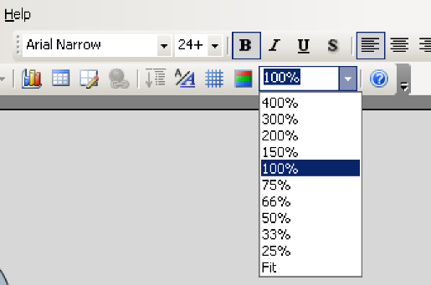
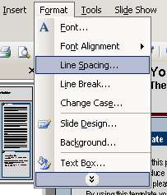
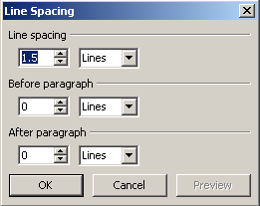
Abstract title
Author/s Affiliations
About this template
Changing the colors
Importing picture files
Discussion
This free template was designed to produce a 90*120 cm poster.
You can use it and modify it as you please for your personal use only. All we ask is that you do not remove our logo from the bottom left and you consider our printing services at printing time. By using this template your poster will look professional, easy to read and save you time from trying to figure out proper placement of titles, subtitles and text body.
The colors we have chosen for this template work very well when printed. They help the content stand out without the stark white look so common with other presentation posters. If you need to change the colors and use your own color scheme got to VIEW>MASTER>SLIDE MASTER to access the elements of the background.
It’s always good to use the largest images you have available for your poster. Avoid images taken from the web and avoid copying and pasting images. Instead try to INSERT>PICTURE>FROM FILE to bring images to your poster.
Note: You can add text boxes, images as you required in to the template.
Although PowerPoint is very forgiving when it comes to printing low resolution images, if you scale your images more than 200% after you bring them in, the image quality will suffer. See the example below:
Original image at 100%, enlarged 200% and 400%.
Suggestion: An easy way to see what an image is going to print like is to change your VIEW>ZOOM setting to 100% and look at the images up close. What you’ll see at 100% is very close to what your images will look like when printed.
Modifying the Headers
Importing slides from a PowerPoint document with many pages
The yellow and blue headers are a nice way to separate the main topics of your presentation. Click on them to move the around and to change the text as needed.
The most commonly used headers in poster presentations are:
A
Text sizes used
B
References
This template uses the Arial family at several text sizes.
You can use any typeface you wish but what is used here works well with this poster format.
Suggestion: If you cut and paste text from Word, or another source onto this document your text will maintain its formatting and you will need to change it so it will match the rest of the text on this page.
Refer to the text sizes indicated above.
Charts & Graphs
C
More text…. Blah, blah
Charts & Graphs: To bring in charts and graphs from Excel, Word or other applications, go to EDIT>COPY to copy your chart, come back to PowerPoint, and go to EDIT>PASTE to paste it on the poster. You can scale the charts or graphs as needed.
Suggestion: Press the SHIFT key as you scale your charts or graphs to scale them proportionally.
Sample
Sample
Sample
Sample
If you have the room, changing the line spacing for a selected part of the text adds emphasis and also makes it easier to read.

